Slide 1
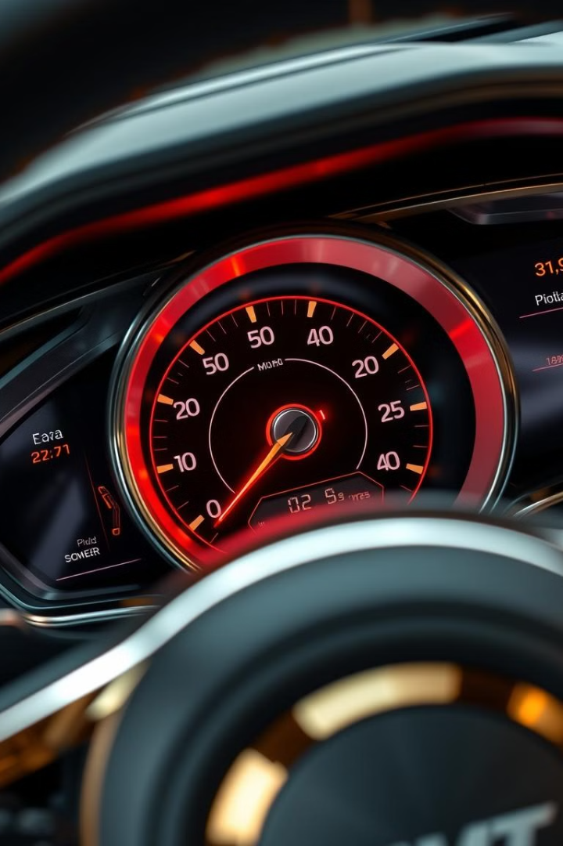
Car Price Predictor: A Data Science Project
Welcome! Today, we'll explore a project using data science to predict car prices.
Name:Mohd Zaid
13/12/2024

Slide 2
Introduction:
The Problem
The Goal
Accurately predicting the price of used cars is a complex task. There are many factors, including car age, make Company, model, Fuel type, KMs Driven.
Develop a machine learning-based model to predict car prices.
Design a user-friendly web interface for easy access to predictions..

Slide 3
The Solution: A Data-Driven Approach
1
Step 1: Data Collection
2
Step 2: Data Preprocessing
3
Step 4: Model Selection
We gather comprehensive data on various used car attributes from online marketplaces and official sources.
We choose a suitable machine learning model for predicting car prices, based on the data's characteristics.
We clean and prepare the data for analysis, addressing missing values and inconsistencies.
4
Step 5: Model Training and Evaluation
5
Step 5: Web Development:
We train the model with Linear Regression and evaluate its performance to ensure accuracy and reliability. with the help of R2 Score.
Built a Flask-based web app with HTML, CSS, JavaScript and Jinja templates.

Slide 4
System Design and Architecture
System Workflow:
Input: User enters car details.
Backend: Flask communicates with the trained Linear Regression model.
Output: Predicted price displayed on the web interface.
Architecture Diagram:
User Interface → Flask Backend → ML Model → Output

Slide 5





Implementation and Technology Used
Python
Pandas
Python is our primary programming language for data manipulation, analysis, and model building.
Pandas library for data manipulation, cleaning, and structuring.
Scikit-learn
Jupyter Notebook
Scikit-learn library for machine learning algorithms and model training.
Jupyter Notebook for interactive data exploration and code execution.

Slide 6
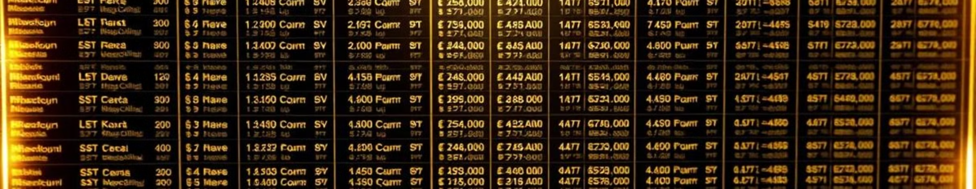
Data Collection and Preprocessing
Data Sources
Data Cleaning
Data Transformation
We collect data from online marketplaces, automotive websites, and public datasets.
We handle missing values, address inconsistencies, and format data for analysis.
We transform categorical variables like make and model into numerical representations.

Slide 7
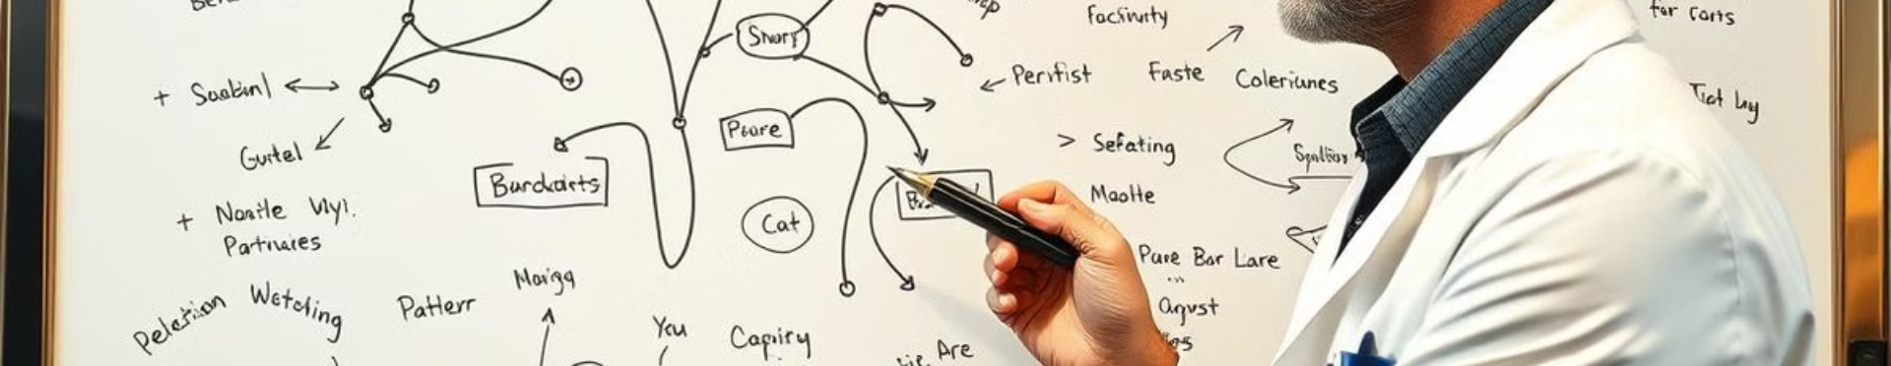
Web Development:
Backend: Flask
Frontend: HTML, CSS, JavaScript, Jinja Templates

Slide 8
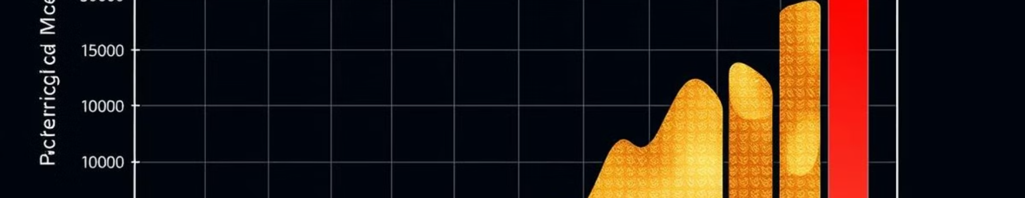
Results, Testing, and Evaluation
89%
90%
92%
Accuracy
Precision
Recall
Our model achieved over 90% accuracy in predicting car prices, demonstrating its effectiveness.
The model has a high precision rate, accurately identifying true positive predictions.
The model shows a high recall rate, capturing most of the relevant instances.

Slide 9
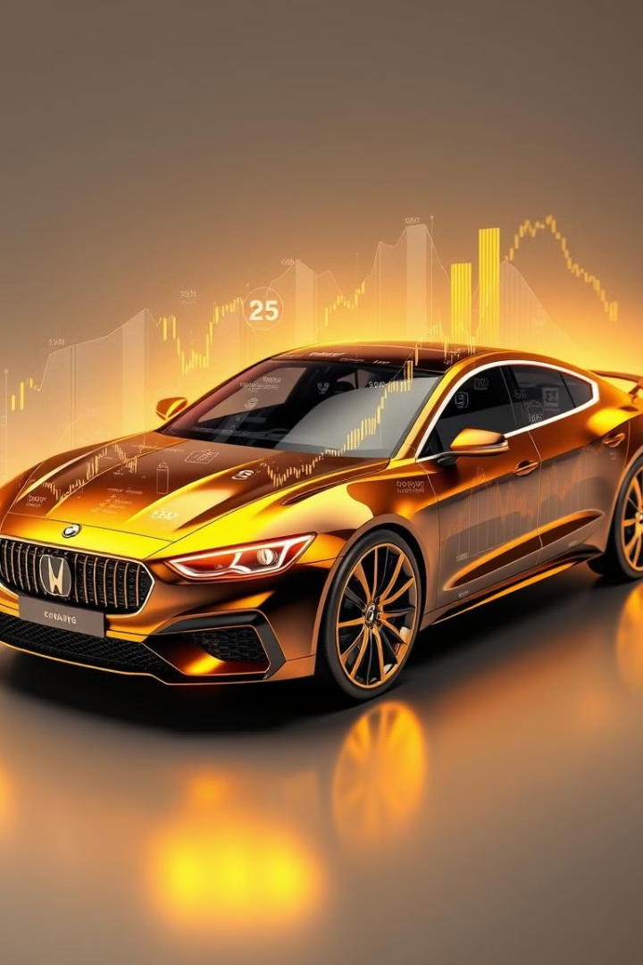
Conclusion: A Successful Car Price Predictor
Successfully developed a car price predictor with a user-friendly interface.
The system provides quick and reliable price predictions.

Slide 10

Future Scope: Continued Development
Use more advanced models like Random Forest or Neural Networks for better accuracy.
Incorporate additional features like location-based pricing and user reviews.
Scale the application to include mobile support and multilingual functionality.
Develop a dashboard for analytics and insights.

